Slide 1


BSD 414:
Lecture 2: Fundamentals of Design Thinking
Notes:
The design thinking process is used by people working in STEM as a method to solving problems. Major organisations often have a ‘Design Thinking’ Team or ‘Innovation’ Team who work solely in this way, such as Transport for London, Uber Eats, AirBnb, Netflix, or OralB. It is an interative process, that challenges assumptions and develops open minded creativity. In its entirety it has 6 steps, and normally focuses on a user or a particular group. The stages are: empathise, define, Ideate, prototype, test, implement. As students may not choose to focus their problem on a particular person, or group of people we have simplified the process to include 4 steps: define, ideas, prototype, test. The infographic on the slide shows that the testing should help then inform your idea to create a better prototype and test again. This iterative cycle then creates a better design in order to implement.

Slide 2
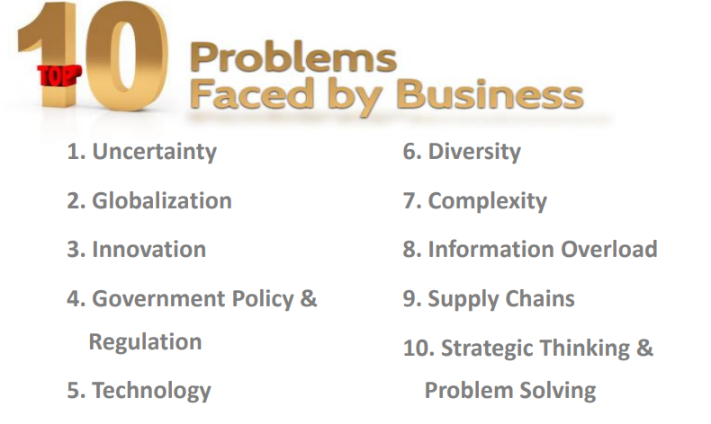

Introduction to Design Thinking

Slide 3
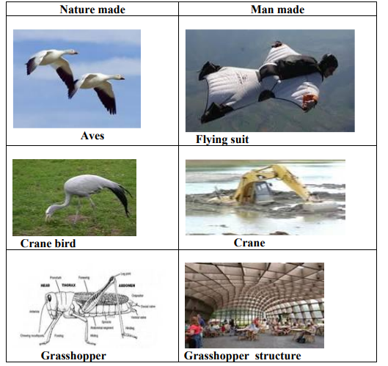
Introduction to Design Thinking

Slide 4
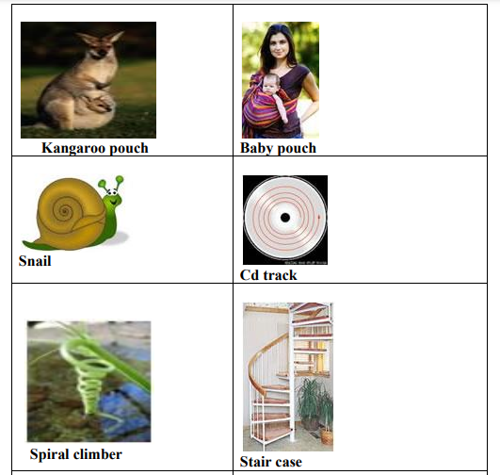
Introduction to Design Thinking

Slide 5
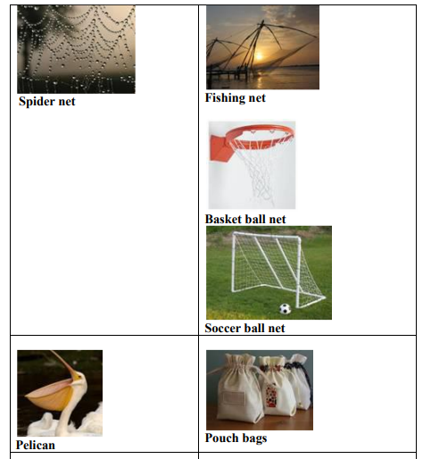
Introduction to Design Thinking

Slide 6
Introduction to Design Thinking
In the Harvard Business Review article “Why Design Thinking Works,” Jeanne Liedtka reveals the results of a seven-year study she did looking at 50 business projects in a range of sectors.
What she found was this: “I have seen that…design thinking…has the potential to do for innovation exactly what TQM [total quality management] did for manufacturing: unleash people’s full creative energies, win their commitment, and radically improve processes.”

Slide 7
Definition
“Design thinking is a human-centered approach to innovation that draws from the designer's toolkit to integrate the needs of people, the possibilities of technology, and the requirements for business success.”
— Tim Brown, CEO of IDEO
Source and more information: https://voltagecontrol.com/blog/8-great-design-thinking-examples/

Slide 8
Definition
Design thinking is different from other innovation and ideation processes in that it’s solution-based and user-centric rather than problem-based. This means it focuses on the solution to a problem instead of the problem itself. For example:
if a team is struggling with transitioning to remote work, the design thinking methodology encourages them to consider how to increase employee engagement rather than focus on the problem (decreasing productivity)

Slide 9
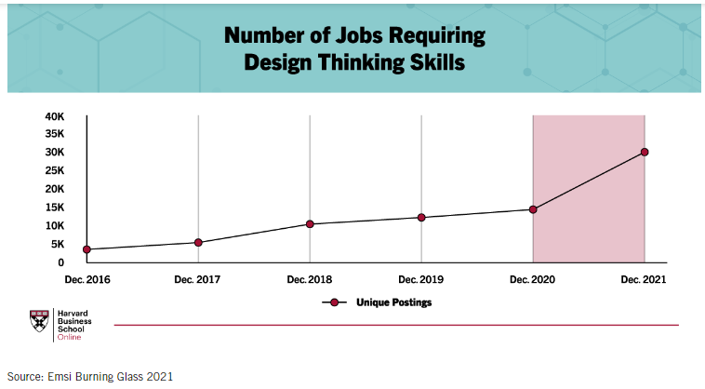
INSIGHTS

Slide 10
INSIGHTS
As of December 2021, the most common occupations requiring design thinking skills were:
Marketing managers
Executives
Industrial engineers
Graphic designers
Software developers
General and operations managers
Management analysts
Personal service managers
Architectural and engineering managers
Computer and information systems managers

Slide 11
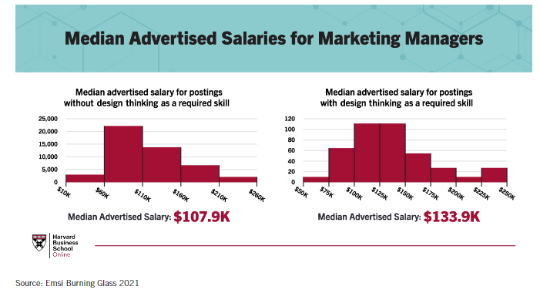
INSIGHTS

Slide 12
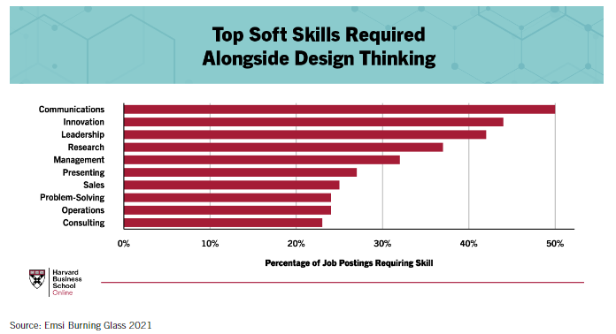
INSIGHTS

Slide 13
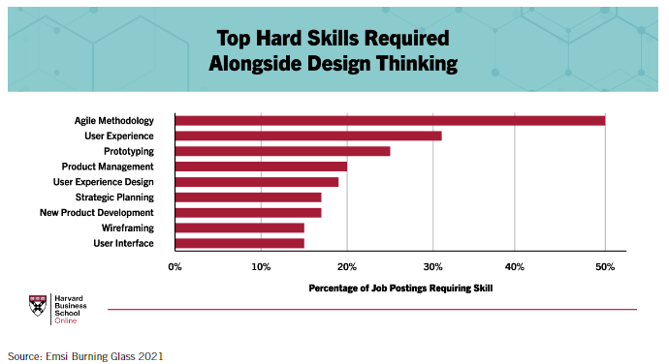
INSIGHTS

Slide 14
INSIGHTS
A successful organization thrives because it is able to deliver products or services that satisfies and excites its customers in one form or another.
In today's increasing complexity of modern technology and modern business, customers are increasingly choosing products and services based on the quality of the experiences they have with them.

Slide 15
Why Design Thinking Workshops
New Insights of design thinking concepts to improve organizational performance
Solutions to solve complex challenges through the process of structured design thinking
Drive better results by combining design thinking with analytical decision making.
Framework for building an environment that fosters creativity.
New ways to collaborate across all functions of the organization

Slide 16
How does an organization keep its products relevant, engagement and meaningful to take care of its customers?

Slide 17
To help meet these challenges, an approach known as "Design Thinking" is playing a greater role in finding meaningful pathways its process and tools are increasingly being adopted in organizational innovation initiatives. Design Thinking is a human-focused, customer-centric and prototype-driven innovative design process.

Slide 18
Examples
Some of the world’s leading brands, such as Apple, Google, Samsung, GE, have rapidly adopted the Design Thinking approach and Design Thinking is being taught at leading universities around the world, including d.school, Stanford, Harvard and MIT.

Slide 19
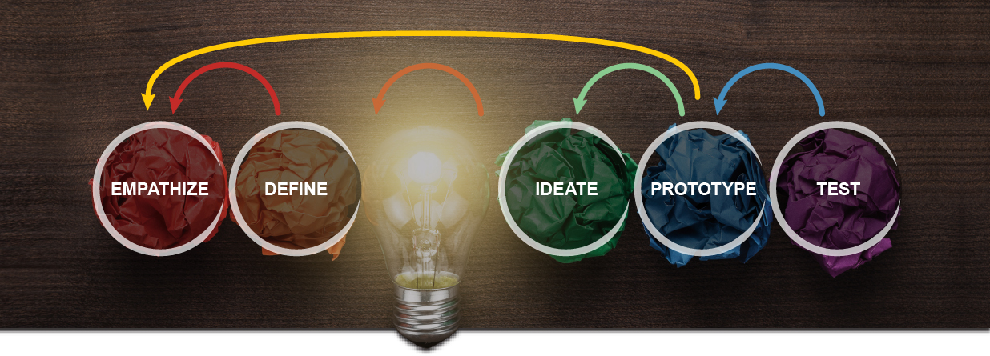
Design Thinking Process

Slide 20
Empathize—Research Users' Needs
The ability to understand and share the feelings of another
Ability to sense other people's emotions, coupled with the ability to imagine what someone else might be thinking or feeling
The team aims to understand the problem, typically through user research. Empathy is crucial to design thinking because it allows designers to set aside your assumptions about the world and gain insight into users and their needs.

Slide 21
Empathize—Research Users' Needs
Gain an empathic understanding of the problem you are trying to solve.
Consulting experts to find out more about the area of concern through observing
Engaging and empathizing with people to understand their experiences and motivations
Immersing yourself in the physical environment so you can gain a deeper personal understanding of the issues involved.
Empathy is crucial to a human-centered design process such as Design Thinking, and empathy allows design thinkers to set aside their own assumptions about the world in order to gain insight into users and their needs.

Slide 22
Empathy
EXEMPLARY TOOLS
Flip chart
Empathy map
Observation
Questionnaire
Ethnographic interviews
Sticky notes
Analysis of the environment and needs in the context of functionality
Whiteboard

Slide 23
Define—State Users' Needs and Problems
Once the team accumulates the information, they analyze the observations and synthesize them to define the core problems. These definitions are called problem statements. The team may create personas to help keep efforts human-centered.

Slide 24
Define—State Users' Needs and Problems
During the Define stage, you put together the information you have created and gathered during the Empathize stage.
This is where you will analyze your observations and synthesize them in order to define the core problems that you and your team have identified up to this point.
You should seek to define the problem as a problem statement in a human - centered manner.

Slide 25
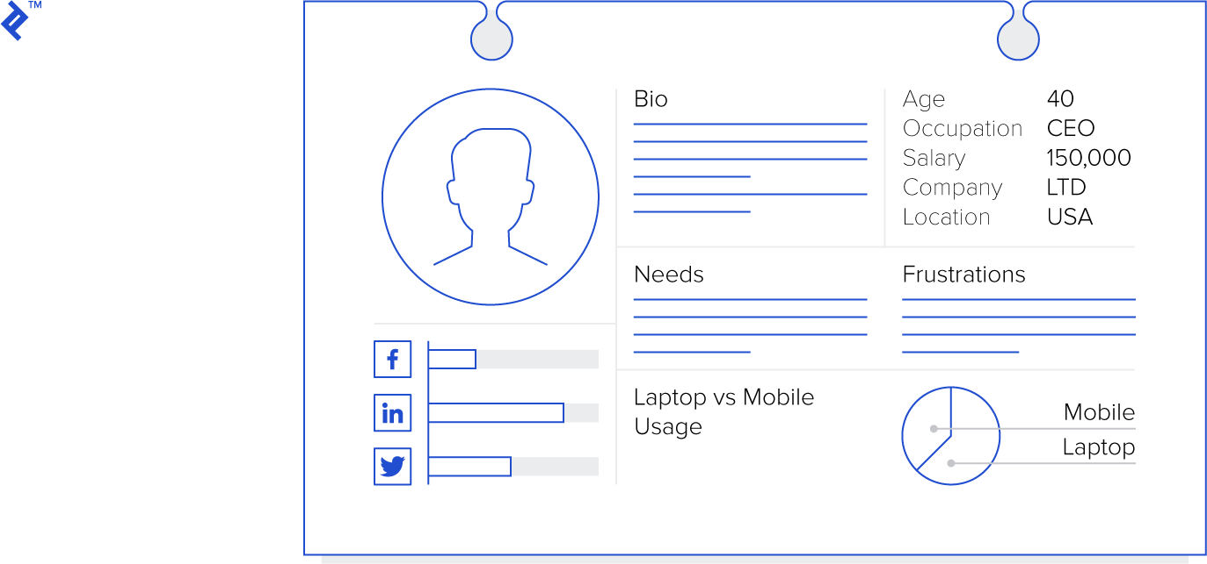
Define—State Users' Needs and Problems

Slide 26
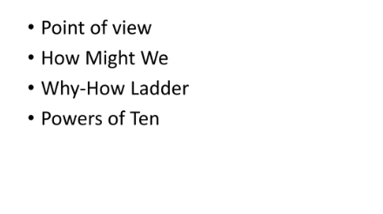
Define—State Users' Needs and Problems

Slide 27
Ideate—Challenge Assumptions and Create Ideas
With the foundation ready, teams gear up to “think outside the box.” They brainstorm alternative ways to view the problem and identify innovative solutions to the problem statement

Slide 28
Ideate—Challenge Assumptions and Create Ideas
During the third stage of the Design Thinking process, designers are ready to start generating ideas.
You’ve grown to understand your users and their needs in the Empathize stage, and you’ve analyzed and synthesized your observations in the Define stage, and ended up with a human-centered problem statement.
With this solid background, you and your team members can start to "think outside the box" to identify new solutions to the problem statement you’ve created, and you can start to look for alternative ways of viewing the problem

Slide 29
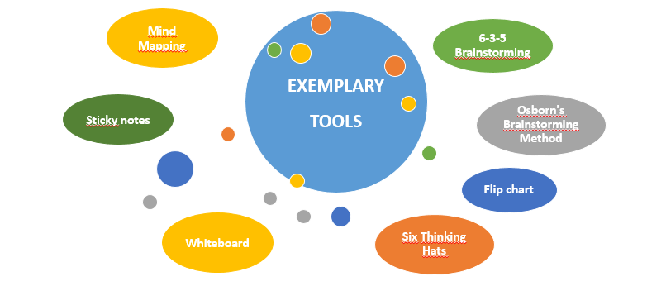
Ideate—Challenge Assumptions and Create Ideas

Slide 30
Ideate—Mind mapping
Mind mapping is a tool that helps you think better, remember, solve problems creatively and take action. Triggers the creativity and flexibility that are needed to solve problems.
Each mind-mapping begins with a central element that is its theme. In the center of the page we place the subject of the mind mapping .
We lead thick branches from the topic - the main slogans in the form of thick lines.
At the end of the main branches we draw another suitably thinner sub-branches with more detailed slogans.
The next levels correspond to more and more details from a given issue. The further from the inside, the smaller their illustration (lines, key words, drawings, pictures).

Slide 31
Ideate—Mind mapping- Remember
Spread a piece of paper horizontally.
Leave space between passwords.
Keywords be integrated with their respective branches.
Solutions should be written in capital letters so that the words are more readable.
The use of different colors is very important. This makes it easier to divide information and remember it.
Special meanings for a given color can be used, e.g. red = important information.
Use images - one image is a thousand words.
You can create additional associations in the form of arrows or dashed lines between given keywords.
Avoid creating very large maps because they will be illegible.

Slide 32
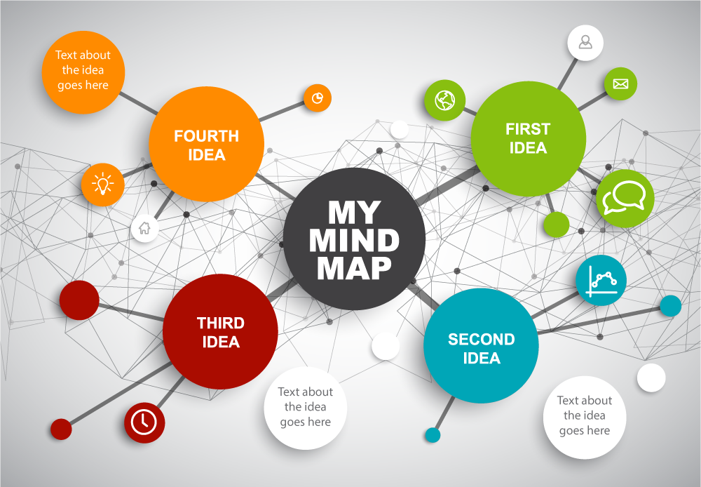

Slide 33
Prototype—Start to Create Solutions
This is an experimental phase. The aim is to identify the best possible solution for each problem. The team produces inexpensive, scaled-down versions of the product (or specific features found within the product) to investigate the ideas. This may be as simple as paper prototypes.

Slide 34

Prototype—Start to Create Solutions
The design team will now produce a number of inexpensive, scaled down versions of the product or specific features found within the product, so they can investigate the problem solutions generated in the previous stage.
Prototypes- shared and tested within the team itself, in other departments, or on a small group of people outside the design team. This is an experimental phase, and the aim is to identify the best possible solution for each of the problems identified
The solutions are implemented within the prototypes, and, one by one, they are investigated and either accepted, improved and re-examined, or rejected on the basis of the users’ experiences.

Slide 35
Test—Try the Solutions Out
The team tests these prototypes with real users to evaluate if they solve the problem. The test might throw up new insights, based on which the team might refine the prototype or even go back to the Define stage to revisit the problem.

Slide 36
Test—Try the Solutions Out
Designers or evaluators rigorously test the complete product using the best solutions identified during the prototyping phase.
This is the final stage of the 5 stage- model, but in an iterative process, the results generated during the testing phase are often used to redefine one or more problems and inform the understanding of the users, the conditions of use, how people think, behave, and feel, and to empathize

Slide 37
Which Problems Can Design Thinking help to solve
Redefining Value
Human-centered Innovation
Quality of life
Problems affecting diverse groups of people
Involving multiple systems
Shifting markets and Behaviors
Coping with Rapid social or market changes
Issues relating to corporate culture
Issues relating to new technology

Slide 38
Which Problems Can Design Thinking help to solve
Re-Inventing Business models
Addressing rapid changes in Society
Complex unsolved societal challenges
Scenario’s involving multi disciplinary teams
Entrepreneurial initiatives
Education advances
Medical Breakthroughs
Problems that data can’t solve

Slide 39
PRODUCT PLANNING
Developing the product concept:
The first phase of product planning is developing the product concept. Marketing managers usually create ideas for new products by identifying certain problems that consumers face or various customers need.
Studying the market:
The next step in the product planning process is studying the competition. Secondary research usually provides details on key competitors and their market share, which is the percent of total sales that they hold in the marketplace.

Slide 40
PRODUCT PLANNING
Market research:
A small company should consider doing both qualitative and quantitative marketing research for its new product. Focus groups are an example of qualitative information. Focus groups allow companies to ask their consumers about their likes and dislike of a product in small groups
Product introduction:
If the survey results prove favorable, the company may decide
to sell the new product on a small scale or regional basis.
During this time, the company will distribute the products in one or more

Slide 41
PRODUCT PLANNING
Product life cycle:
Product planning must also include managing the product through various stages of its product life cycle.
These stages include the introduction, growth, maturity and decline stages. Sales are usually strong during the growth phase, while competition is low.

Slide 42
Features of Design Thinking
Design Thinking is an integrative approach
The working environment for this process is designed to promote creativity
Focuses on early customer orientation
Emphasizes Empathy
Strives to make ideas tangible at an early stage
Pay attention to the diversity of the participants
Creates team-oriented, creative working spaces
Combines analytical phases (collecting, organizing, evaluating information) and synthetic phases

Slide 43
Benefits of Design Thinking
Reduced Risk of Launching New Ideas
Innovative Solutions and Offerings :
Faster Pace of Learning :
Happier Users:
More Revenue and Returns

Slide 44
The Sweet Spot for Innovation
The Sweet Spot for Innovation
Desirability - A desirable solution, one that your customer really needs
Feasibility- A feasible solution, building on the strengths of your current operational capabilities
Viability- A profitable solution, with a sustainable business model.

Slide 45
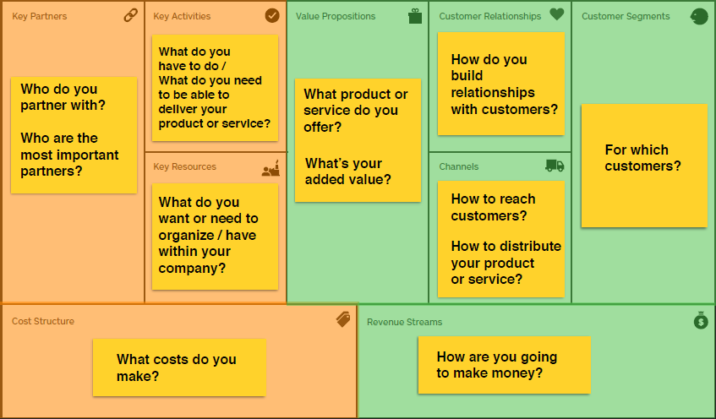
The Business Model Canvas

Slide 46
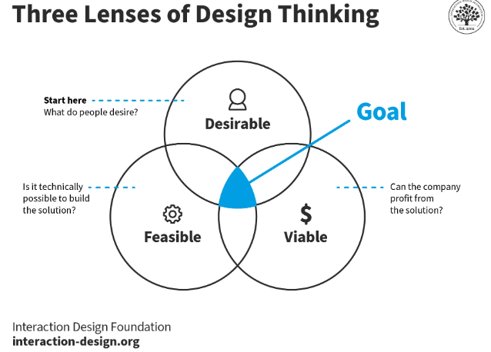
End Goal

Slide 47
End Goal
Desirability: Meet People’s Needs
The design thinking process starts by looking at the needs, dreams and behaviors of people—the end users. The team listens with empathy to understand what people want, not what the organization thinks they want or need. The team then thinks about solutions to satisfy these needs from the end user’s point of view.

Slide 48
End Goal
Feasibility: Be Technologically Possible
Once the team identifies one or more solutions, they determine whether the organization can implement them. In theory, any solution is feasible if the organization has infinite resources and time to develop the solution. However, given the team’s current (or future resources), the team evaluates if the solution is worth pursuing. The team may iterate on the solution to make it more feasible or plan to increase its resources (say, hire more people or acquire specialized machinery).

Slide 49
End Goal
Viability: Generate Profits
A desirable and technically feasible product isn’t enough. The organization must be able to generate revenues and profits from the solution. The viability lens is essential not only for commercial organizations but also for non-profits.

Slide 50


Notes:
The design thinking process is used by people working in STEM as a method to solving problems. Major organisations often have a ‘Design Thinking’ Team or ‘Innovation’ Team who work solely in this way, such as Transport for London, Uber Eats, AirBnb, Netflix, or OralB. It is an interative process, that challenges assumptions and develops open minded creativity. In its entirety it has 6 steps, and normally focuses on a user or a particular group. The stages are: empathise, define, Ideate, prototype, test, implement. As students may not choose to focus their problem on a particular person, or group of people we have simplified the process to include 4 steps: define, ideas, prototype, test. The infographic on the slide shows that the testing should help then inform your idea to create a better prototype and test again. This iterative cycle then creates a better design in order to implement.

